Slide 1
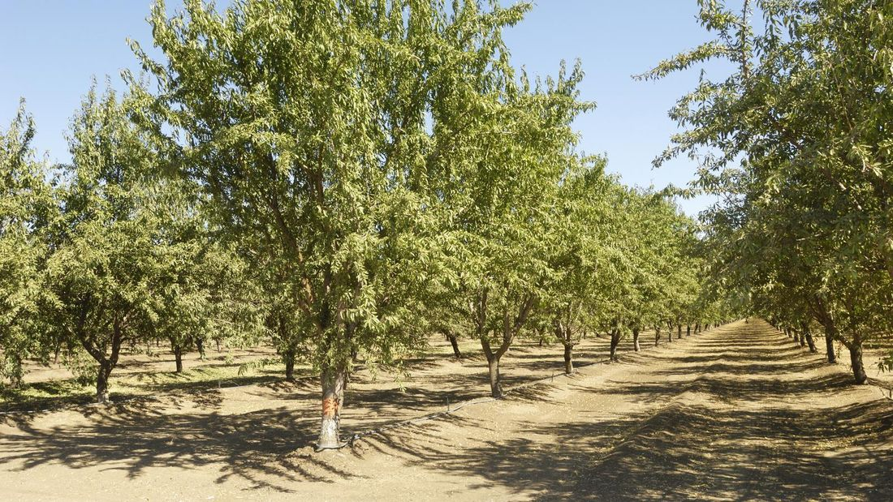
Predicting Almond Yield Stephanie Benavidez and Kimberly Adams
https://www.bunnings.co.nz/diy-advice/garden/planting-and-growing/how-to-grow-an-almond-tree

Slide 2
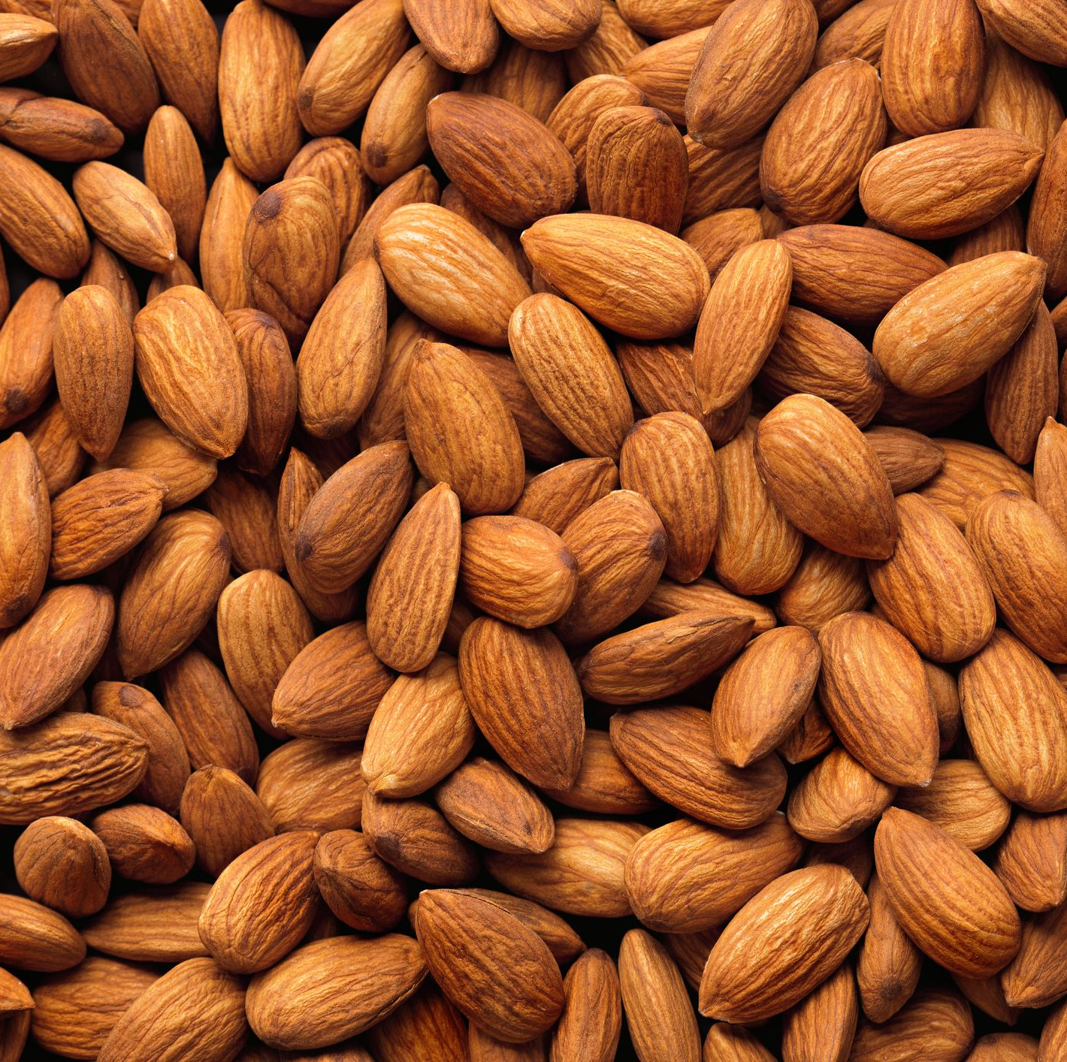
Almonds
Multiple nutritional benefits
Industry generates over $21 billion in revenue each year
Supports over 104,000 jobs in California alone
California produces roughly 80% of the world's supply
91% of farms are family owned
https://www.goodhousekeeping.com/health/diet-nutrition/a19503705/almonds-nutrition/

Slide 3
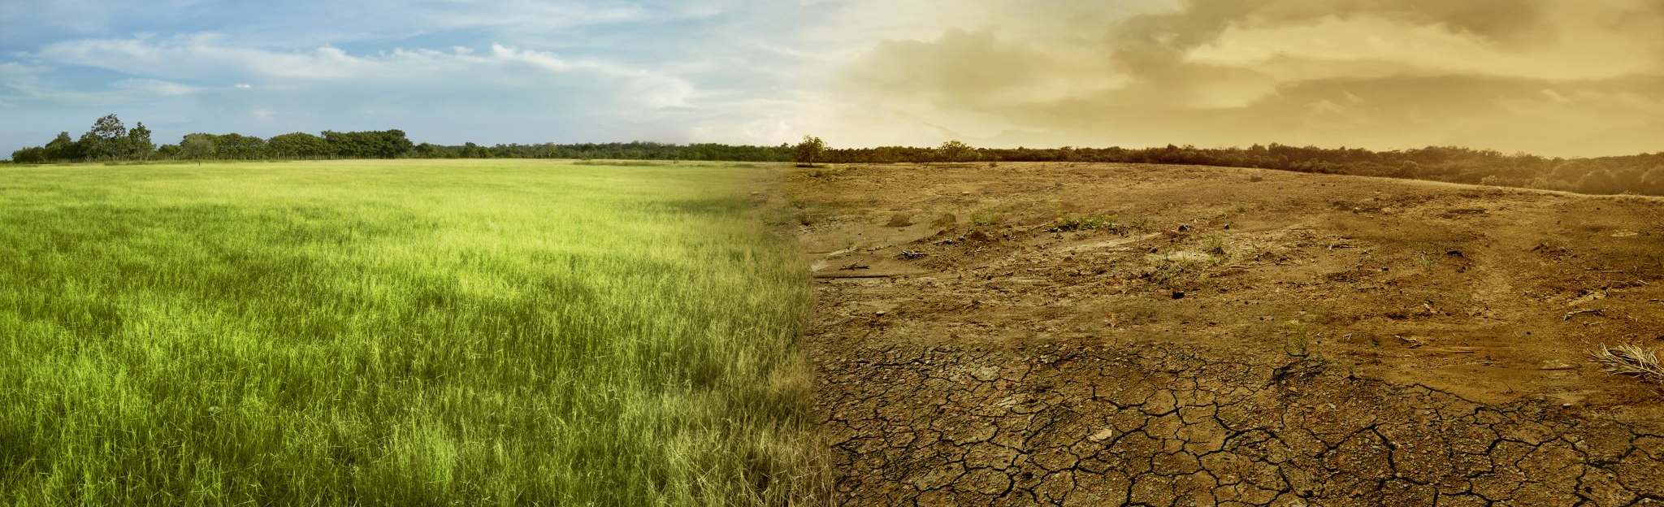
Shifting Climate
Multiple aspects are changing, for example:
Temperature
Rainfall
Frequency and severity of extreme weather events
Potential impacts to the agricultural growing season

Slide 4

Project Questions
Are temperatures showing a positive trend supportive of global warming patterns?
Are crop yields decreasing or increasing over time?
Are there signs that increased costs (i.e., water, fertilizers, pesticides, transportation) have cut into profit margins over time?
If I am a farmer, is it still worth planting almonds next year?

Slide 5
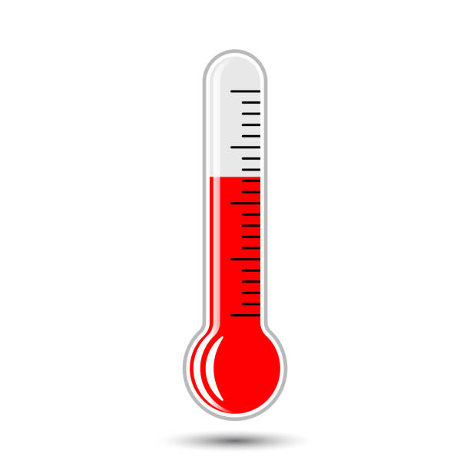
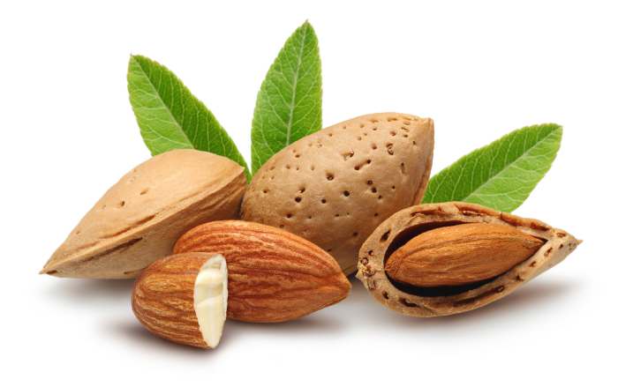
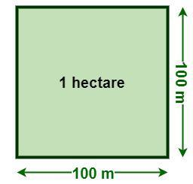



Data
Food and Agriculture Organization (FAO) of the United Nations
Collects measures of important markers of food production, needs, and costs as well as the population characteristics of different countries.
Crop Yield Almonds produced per hectare | Area Harvested Number of hectares harvested | Temperature Change Degrees difference from previous year
Producer Price Amount growers get at crop sale | Exports & Imports Yearly total value of exported and amount of imported crop | Level of Water Stress Proportion of water withdrawn from available sources

Slide 6
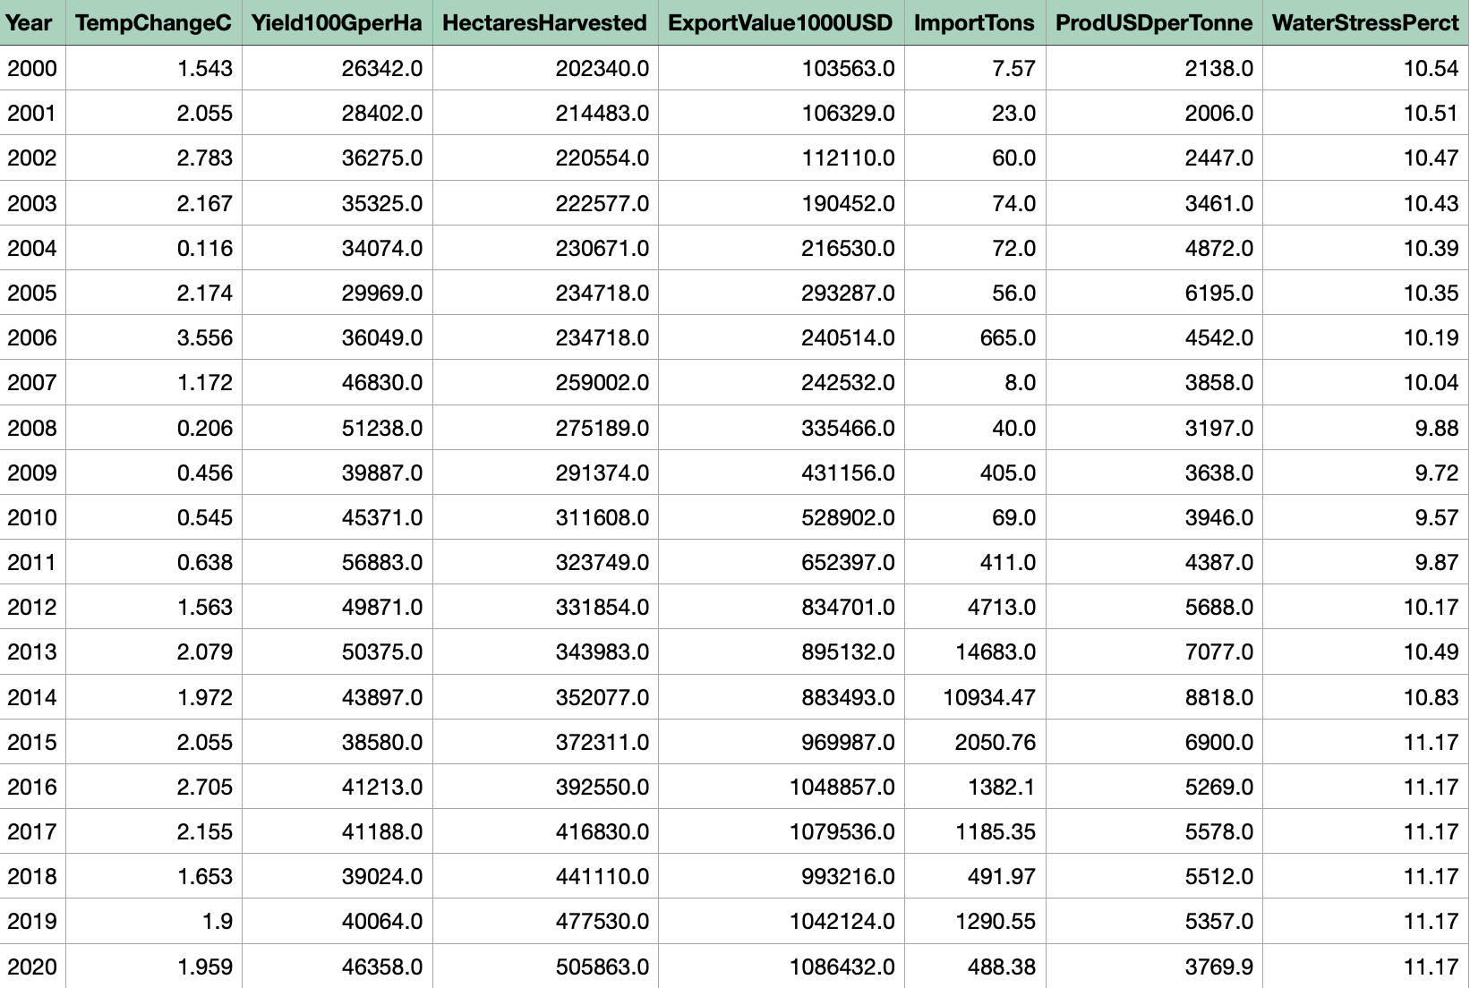
Data Cleanup
Extraction from source
Dropped unnecessary columns
Renamed columns
Subsets
Minimal missing values*
Checked datatypes
Set One | Set Two | Set Three
1961 - 2001 | 1991 - 2001 | 2000 - 2020
All variables except: Producer price Water stress | All variables except: Water stress | All variables

Slide 7

Data Exploration
Box plots
Correlation matrixes
Line graphs

Slide 8
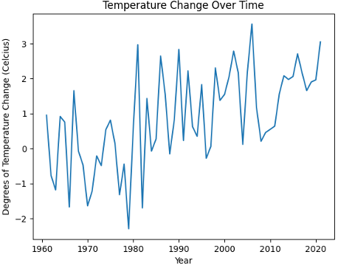
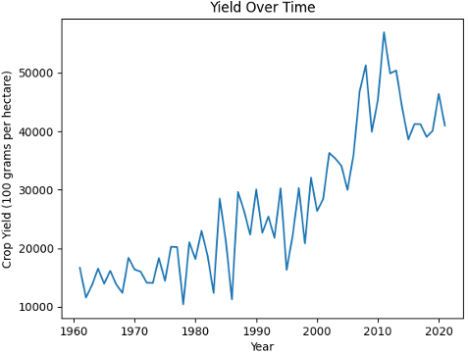
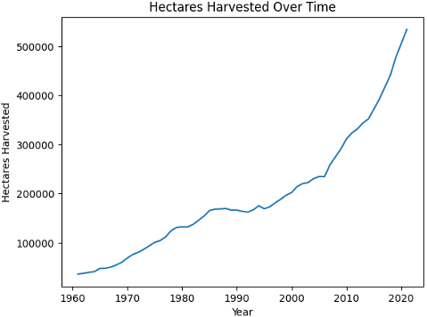
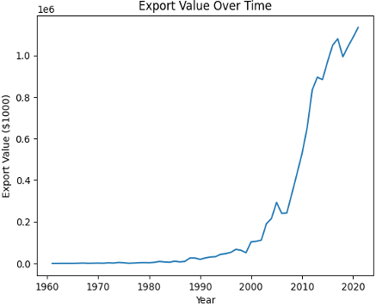
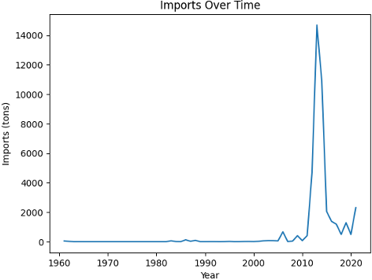
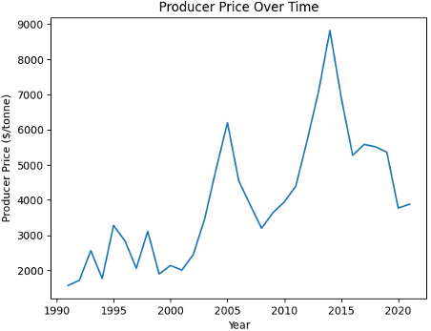
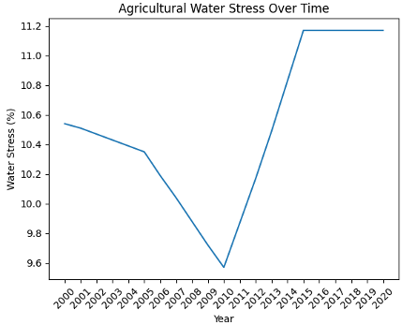
Line Graphs

Slide 9
Preparing the data for modeling
Split each subset into training / test data sets
Train-Test Split for Set One (1961 - 2021, 60 years)
Train 1961 – 2010, 50 years
Test 2011 – 2021, 10 years
Train-Test Split for Set Two (1991 - 2021, 30 years).
Train 1991 – 2015, 25 years
Test 2016 – 2021, 5 years

Slide 10
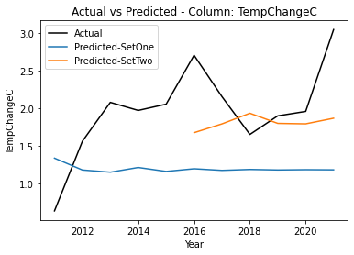
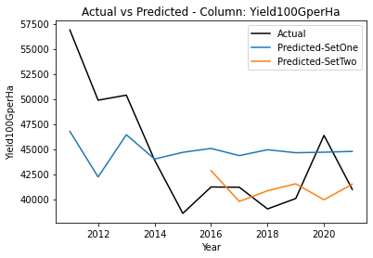
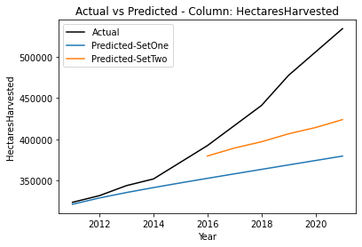
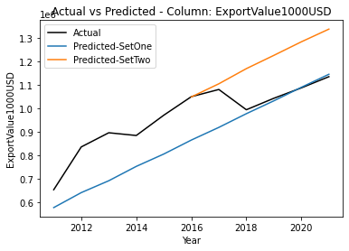
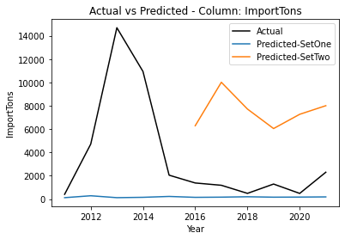
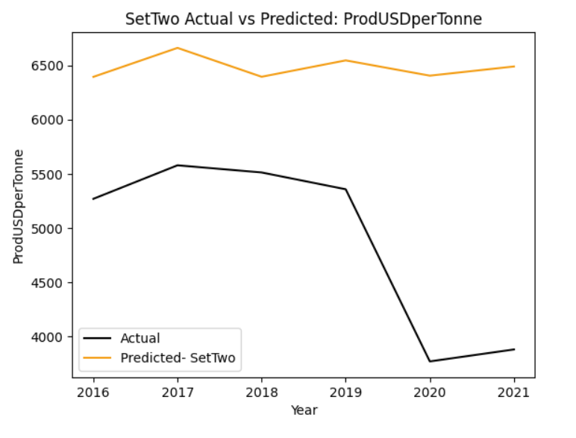
ARIMA Modeling

Slide 11
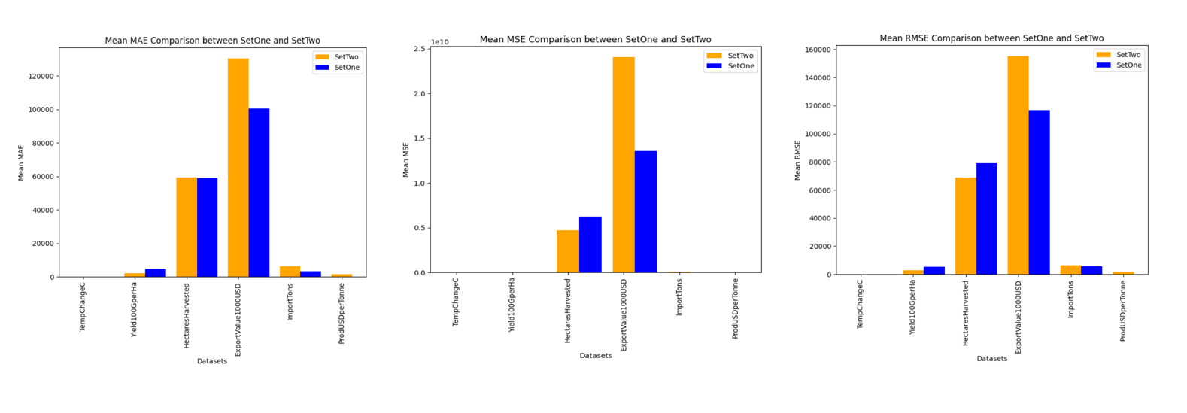
Metrics
Overall, the ARIMA model for Set One had lower error.
Export values consistently had the highest error rates.
Temperature change and yield had fairly low error rates.

Slide 12
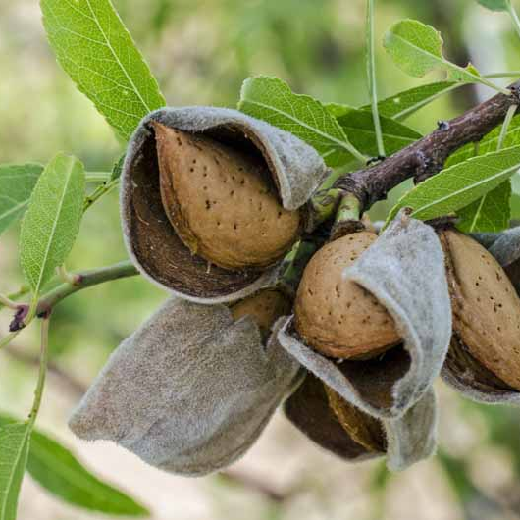
Model Conclusions
The ARIMA model for Set One had lower error than Set Two.
Most likely due to variation smoothing from the longer time frame.
None of the model predictions were remarkably accurate.
Best predictions were for temperature change and yield.
But…model sometimes overestimates the crop yield

Slide 13
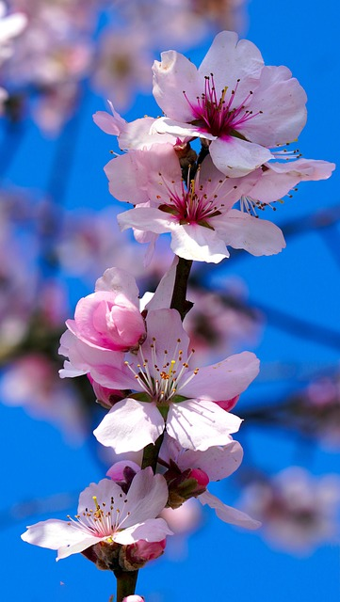
Answers to Original Questions
Are temperatures showing a positive trend supportive of global warming patterns?
Yes, temperatures show a positive trend over time within the data sources.
Are crop yields decreasing or increasing over time?
Crop yields are increasing both in the area harvested AND, in the amount harvested per area unit.
Are there signs that increased costs (i.e., water, fertilizers, pesticides, transportation) have cut into profit margins over time?
Increasing value in exports, but also recent decreases in amount producer gets when selling suggesting lower profit margins.
If I am a farmer, is it still worth planting almonds next year?
Model suggests roughly same crop yield as past couple years, but cost increases may make it less feasible to turn a profit.

Slide 14
Resources
California, A. B. (2016, June). California Almond Industry Facts. Retrieved from almonds.com: https://www.almonds.com/sites/default/files/2016_almond_industry_factsheet.pdf
Climate Change Indicators: Weather and Climate. (2022, August 1). Retrieved from www.epa.gov: https://www.epa.gov/climate-indicators/weather-climate
Crops and Livestock Products Data. (n.d.). Retrieved from www.fao.org: https://www.fao.org/faostat/en/#data/QCL
Food and Agriculture Organization. (2023). Retrieved from www.fao.org: https://www.fao.org/faostat/en/#data
Producer Price Trade Data - Crops and livestock products. (n.d.). Retrieved from www.fao.org: https://www.fao.org/faostat/en/#data/TCL
Producer Prices Data. (n.d.). Retrieved from www.fao.org: https://www.fao.org/faostat/en/#data/PP
SDG Indicators. (n.d.). Retrieved from www.fao.org: https://www.fao.org/faostat/en/#data/SDGB
Temperature Change on Land Data. (n.d.). Retrieved from www.fao.org: https://www.fao.org/faostat/en/#data/ET
Zelman, K. M. (2022, November 10). Health Benefits of Almonds. Retrieved from www.webmd.com: https://www.webmd.com/diet/health-benefits-almonds

